Slide 1
Global Pandemics and the Rural Response: Rural Georgia’s Challenge and Response to COVID-19
Joe Robbins
Keith Lee
Steven Sainz

Slide 2
Overview
Emergency Management practices tested under COVID-19
Current study analyzes how emergency management collaborative approaches were utilized under COVID-19
Also conducted a Needs Assessment Survey in conjunction with Camden Connection to analyze COVID-19’s impact and county’s response to the pandemic

Slide 3
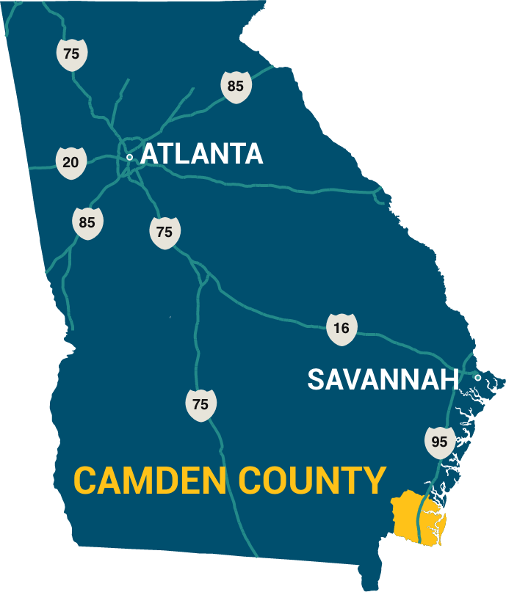
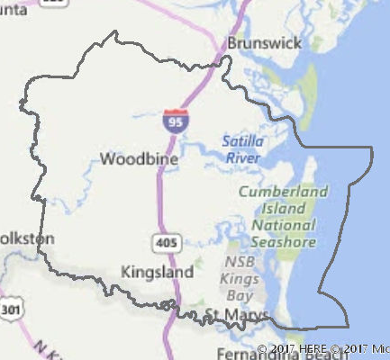
Camden County, Georgia

Slide 4
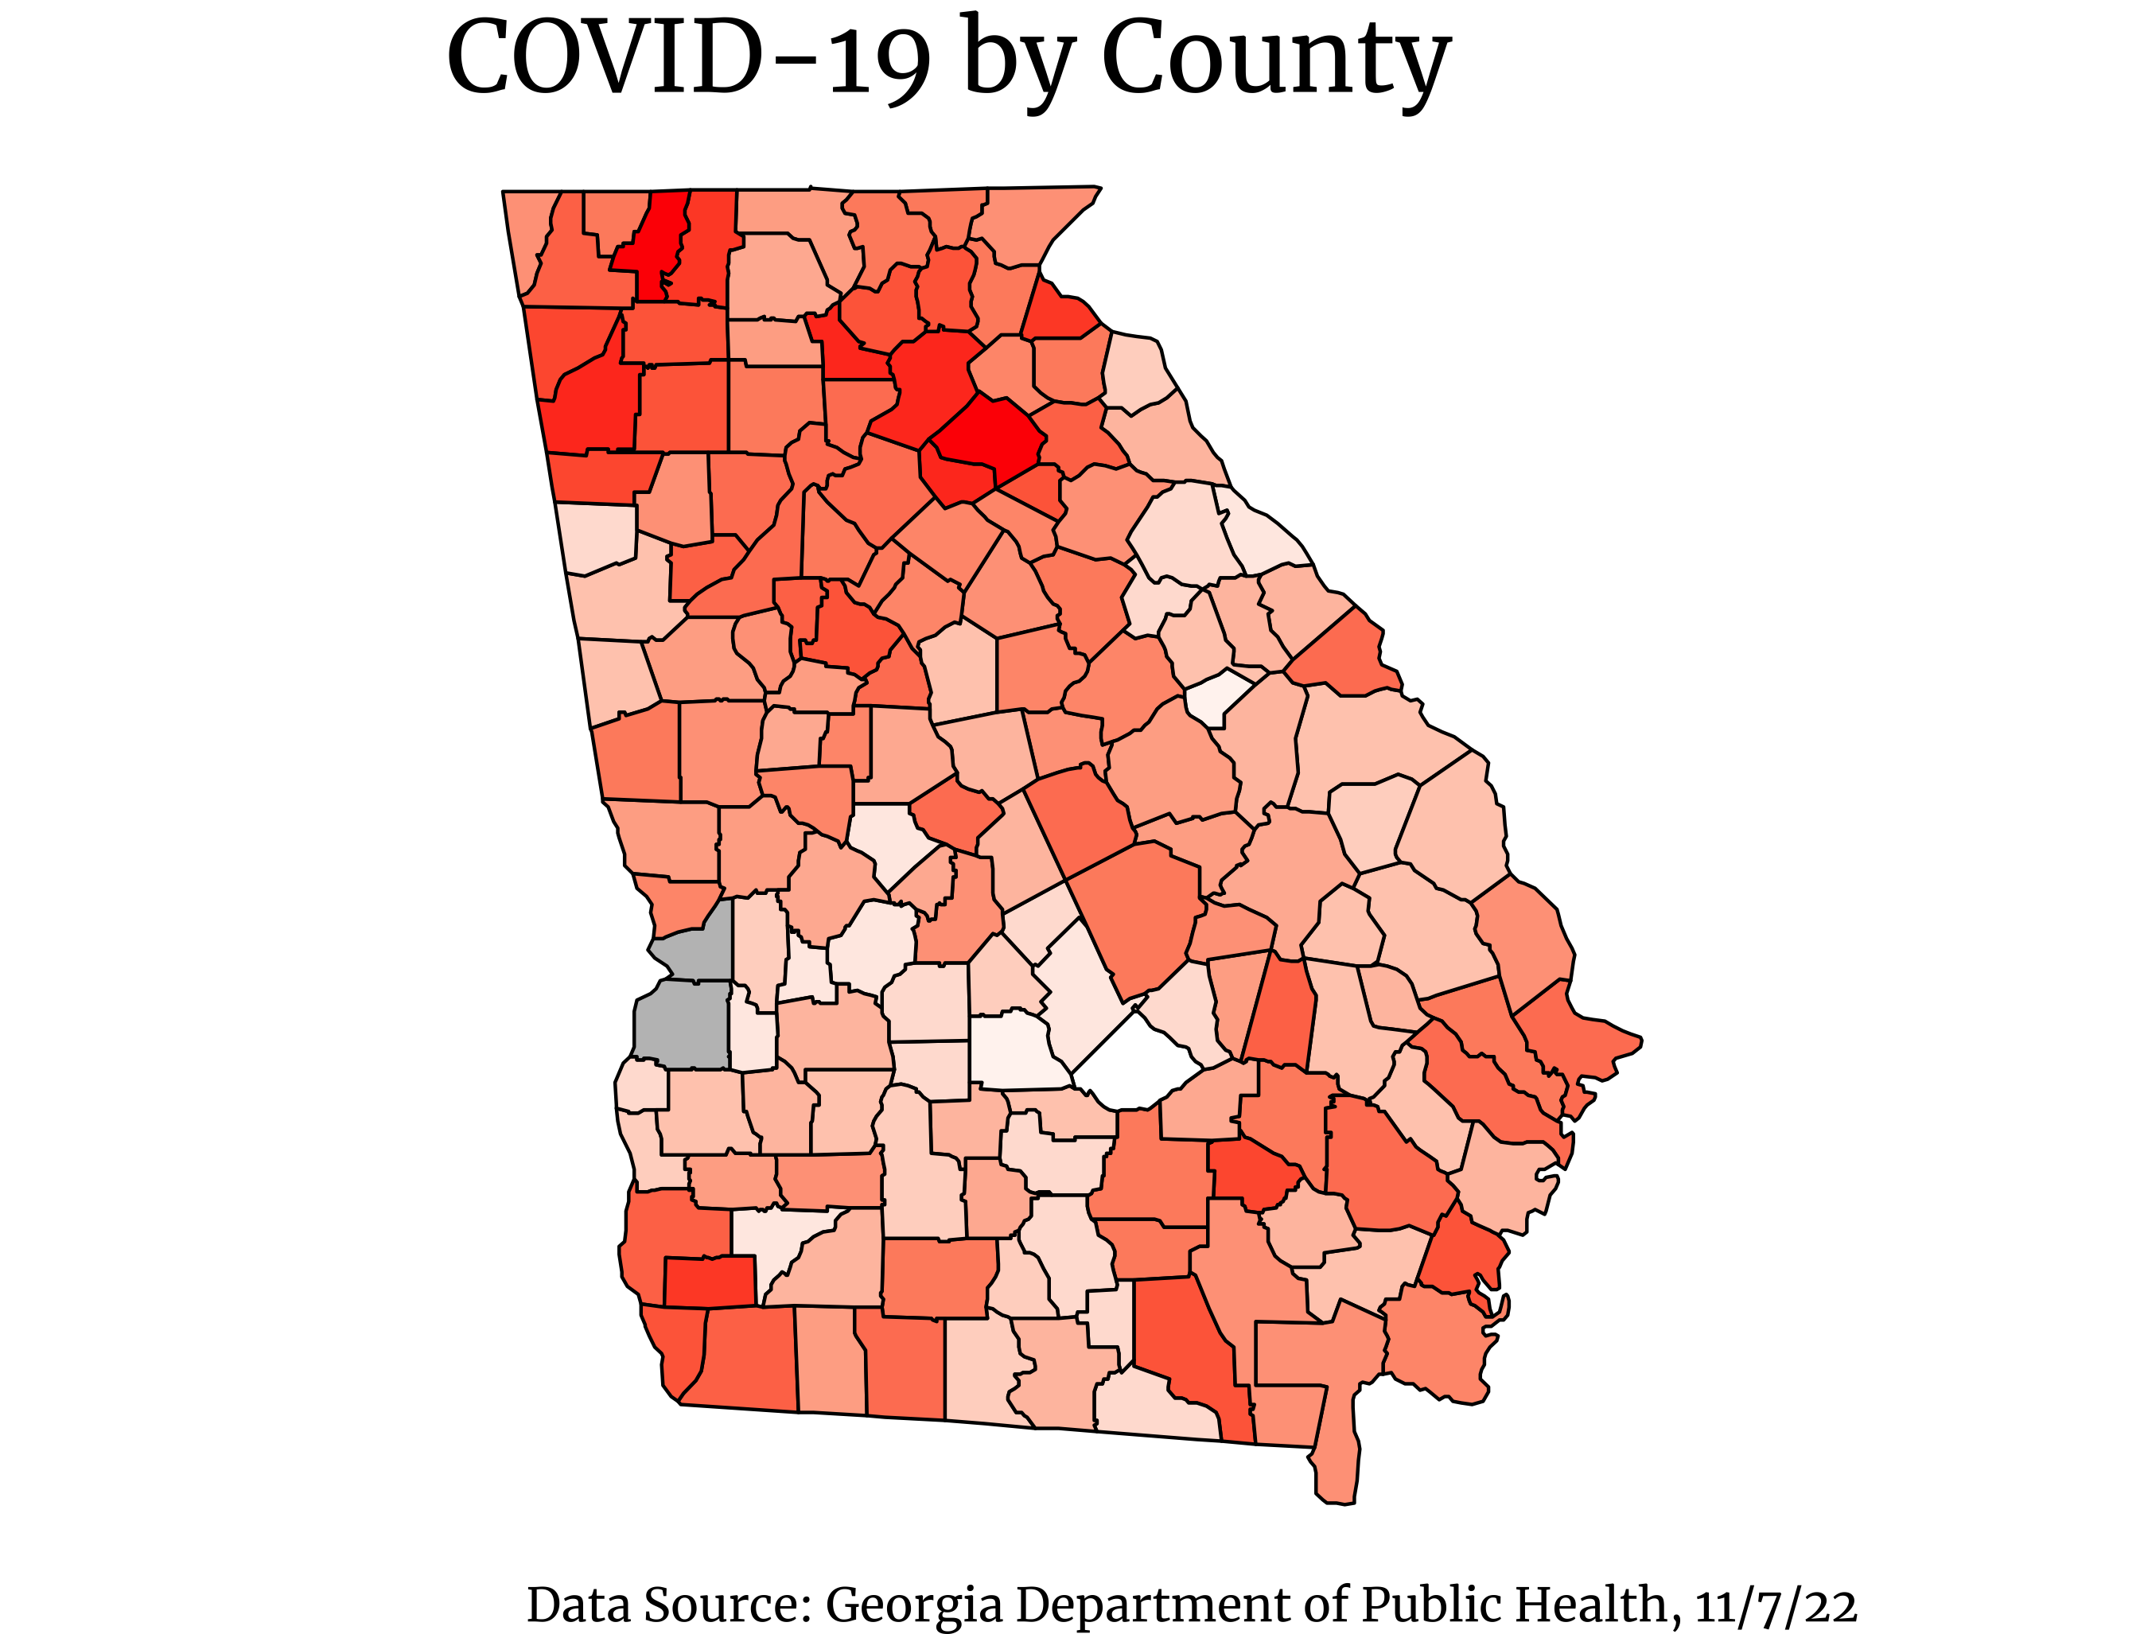
COVID-19 & Georgia
2.5 million deaths and 33,000+ COVID cases in Georgia since 2020
Georgia’s COVID-19 rate has been 26,990 cases per 100k inhabitants
Camden County’s COVID-19 rate has been 24,585 cases per 100k
Surpasses several other counties in the region

Slide 5

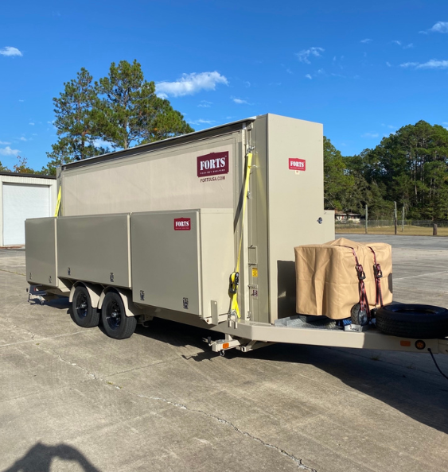



American Rescue Plan Act Funds & Camden County
EMA Mobile Field Office
($175k; Camden County)
Camden House Renovations ($10k)
New Public Health Dept. ($387k; Camden County)
14 new vehicles for Sheriff’s Office
($950k; Camden County)
No Cost Swim Lessons
($25k; St. Mary)

Slide 6
Needs Assessment Survey
Housing | 77.41% own their own home
Single Parent Households | 20.33%
Households with minor residents | 41.31%
Households with residents 65+ | 28.68%
Employment Affected by COVID | 29.12%
Require Child Care | 14.95%
Use Community / Non-profit services | 12.52%
Internet Access | 98.95%
Food Security | 74.10%

Slide 7
